Slide 1
The factors to get your car lost in Toronto and Vancouver
Mouder chen @ Nov2019
gzchenxs@hotmail.com

Slide 2
Define the problem
Thieves are every where. They may steal your wallet, your phone or your bag. No matter what kind of belonging get stolen, it will cause you trouble, big or small. Think about what makes you most trouble if you lose it.
There is a dark industry behind auto theft. As a normal citizen, what we can do is to stay alert in order to minimize the likelihood of losing your vehicle.
How can we avoid auto theft? If we are visiting a place that we know there could be higher chance for this kind of crime. We can be more careful or add extra protection when parking our car there. The problem is how we know if that area is safe or not? This assignment is to tell you what is the factors to get your vehicle lost.

Slide 3
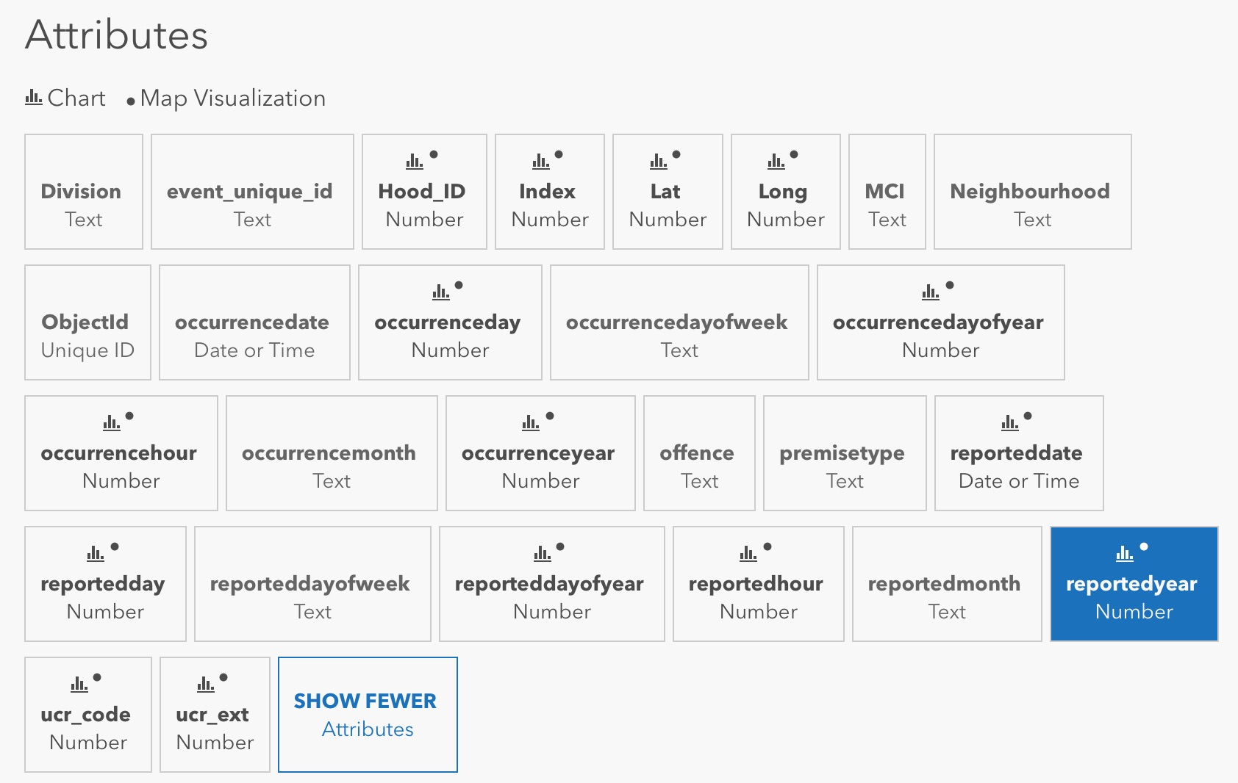
About the data
Theft of vehicle data for Toronto can be downloaded from Toronto Police service
Auto theft data for Vancouver can be downloaded from Vancouver police department
For the venues data we can retrieve from Foursquare service

Slide 4
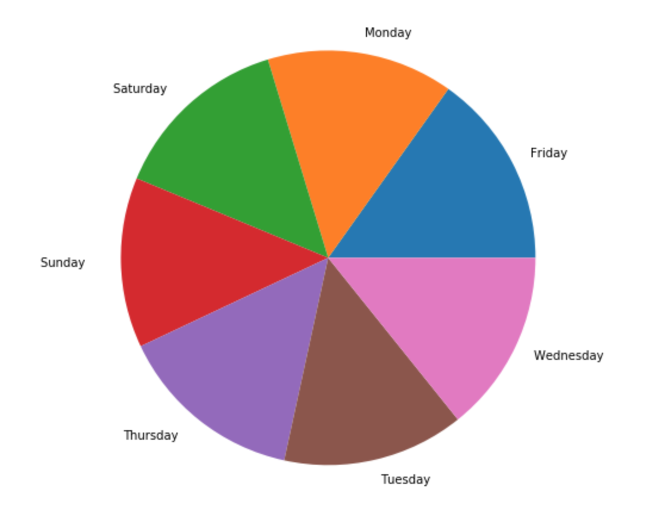
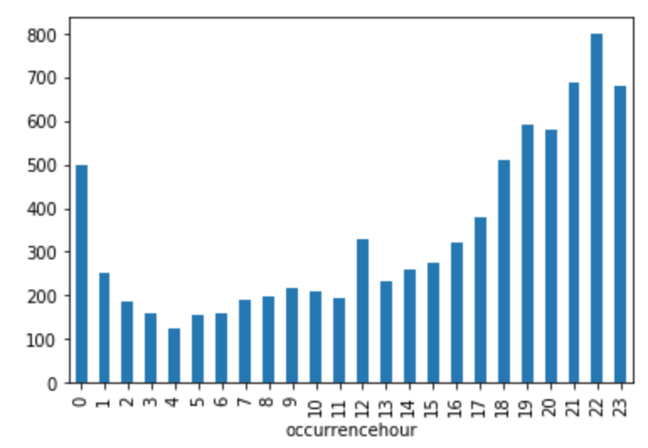
Finding about toronto
The chance to lose your car is similar no matter weekday or weekend
It has much higher chance that you will lose your car after evening till mid night

Slide 5
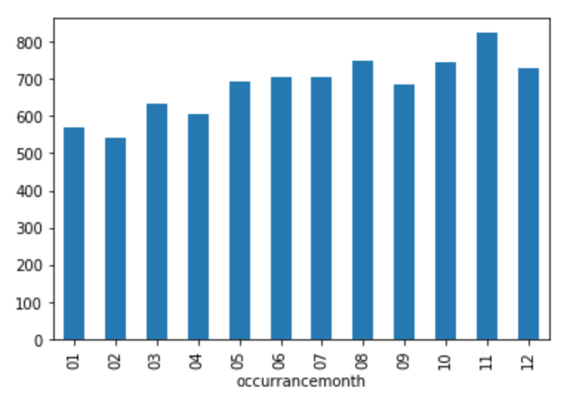
Finding about toronto
When we are comparing with the month and incidents number, we do see there is slightly less incidents in first quarter than other quarters. But in terms of overall incident numbers between winter season and summer season, there is not much difference.

Slide 6
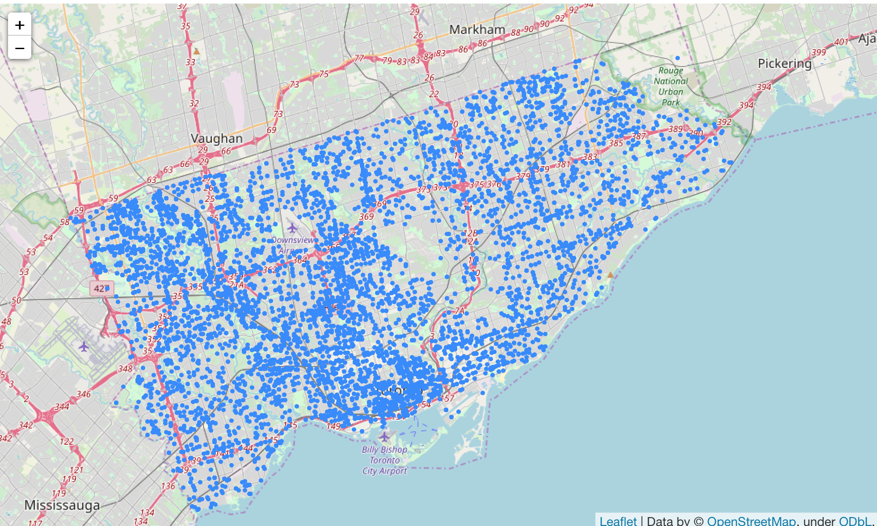
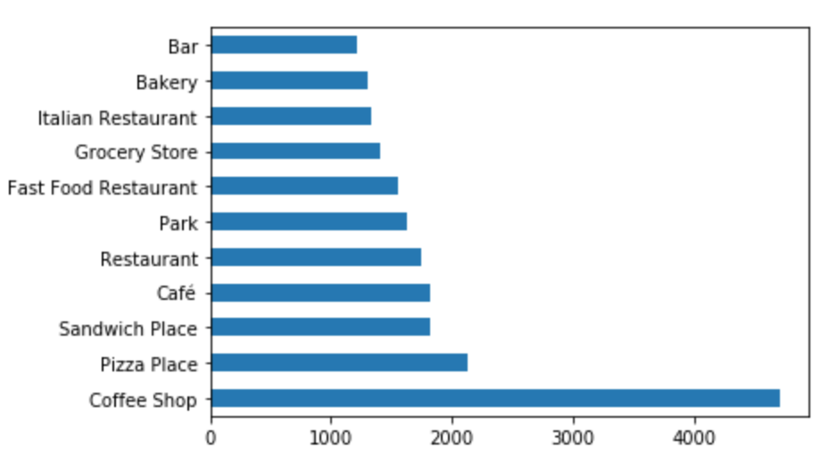
More finding on Toronto
Around the downtown of Toronto, it is a bit more dangerous than the other area.
Top 11 occurrence venues which close to the incident locations (with radius = 300metres). Obviously, coffee shop is so popular for auto theft. But it(coffee shop) maybe an outlier given there are so many coffee shops around Toronto. From the list, it is observed that restaurants are the highest chance avenue to get lose your car in Toronto.

Slide 7
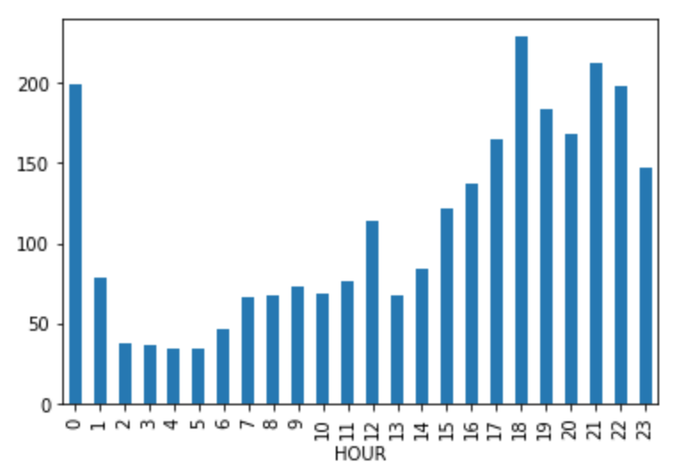
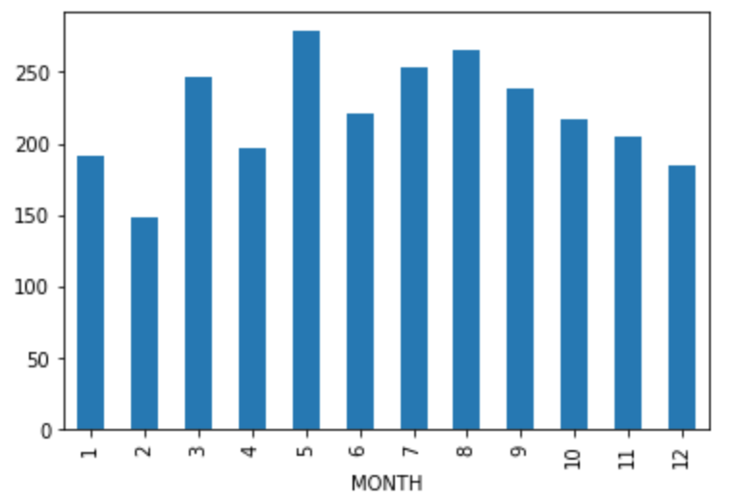
Finding in Vancouver
Similar trend as Toronto, there is higher chance to lose your car from evening till mid night than mid night till afternoon.
For the months vs incident numbers: It is interesting to see that winter has slightly less chance to lose your cars.

Slide 8
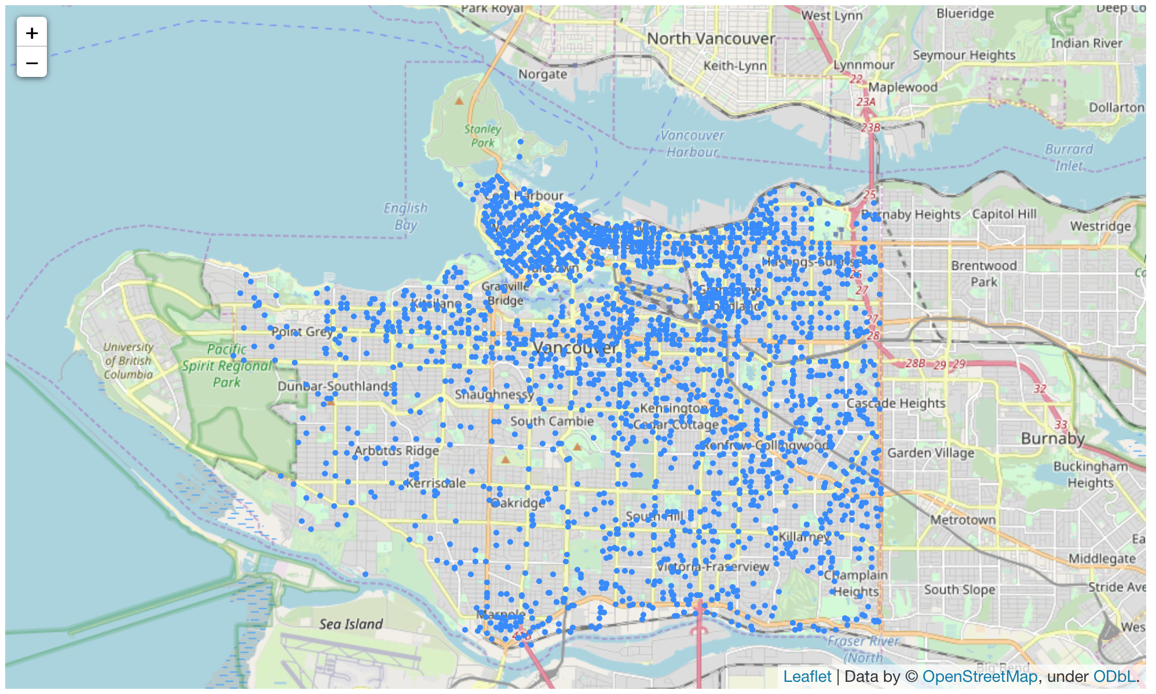
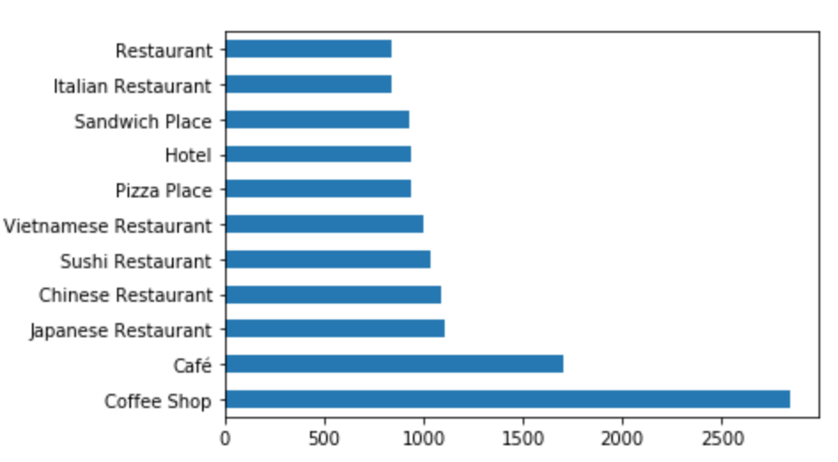
More finding on Toronto
It is more dangerous in North of Vancouver than south of Vancuver.
Top 11 venues which within in 300meters of each incidents. Same as Toronto, Coffee shop is again at the first place with much higher occurrences than other venues. Another similarity as Toronto is that restaurant is most dangerous places, but it is interesting that Asian restaurants are on the top of the list.

Slide 9
Conclusion
Even though there is no complicate method using for the analyze, we can still identify some of relationships between the features we selected and occurrence of the incidents. I believe that it could help for the individual to understand the situation and raise their alert and cooperation can seek improvement on how to provide safer environment for their business. Moreover, it could the society to build a better place for residents who living in the cities. The same approach can be also applied to other cities.

